Slide 1
Matrix Algebra
Methods for Dummies
FIL
January 25 2006
Jon Machtynger & Jen Marchant

Slide 2
Acknowledgements / Info
Mikkel Walletin’s (Excellent) slides
John Ashburner (GLM context)
Slides from SPM courses: http://www.fil.ion.ucl.ac.uk/spm/course/
Good Web Guides
  www.sosmath.com
  http://mathworld.wolfram.com/LinearAlgebra.html
  http://ceee.rice.edu/Books/LA/contents.html
  http://archives.math.utk.edu/topics/linearAlgebra.html

Slide 3
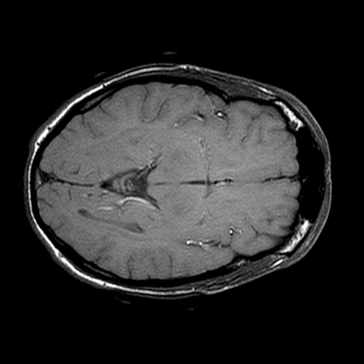
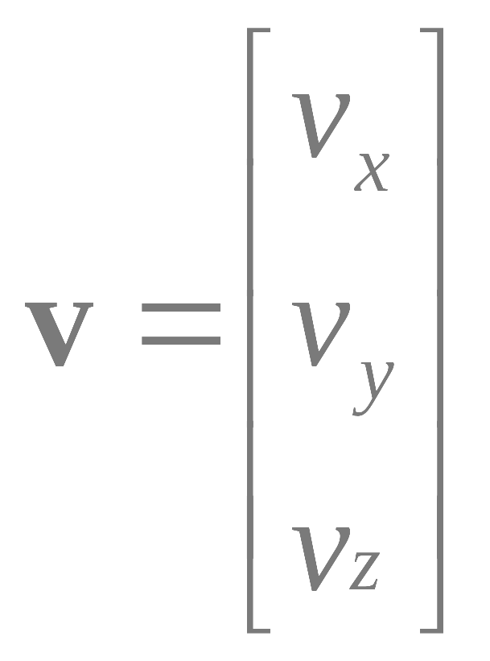
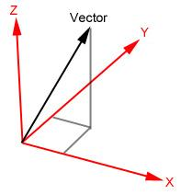
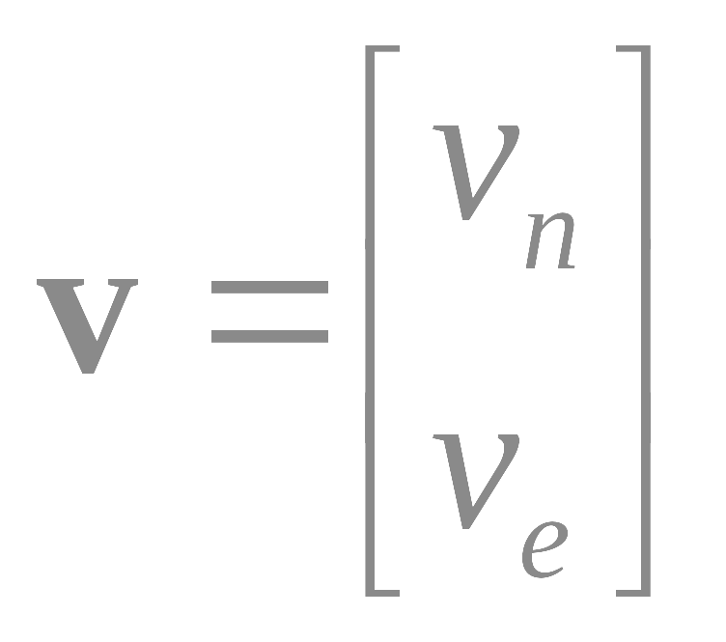
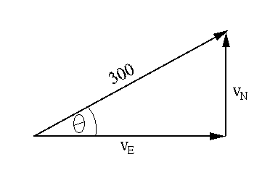


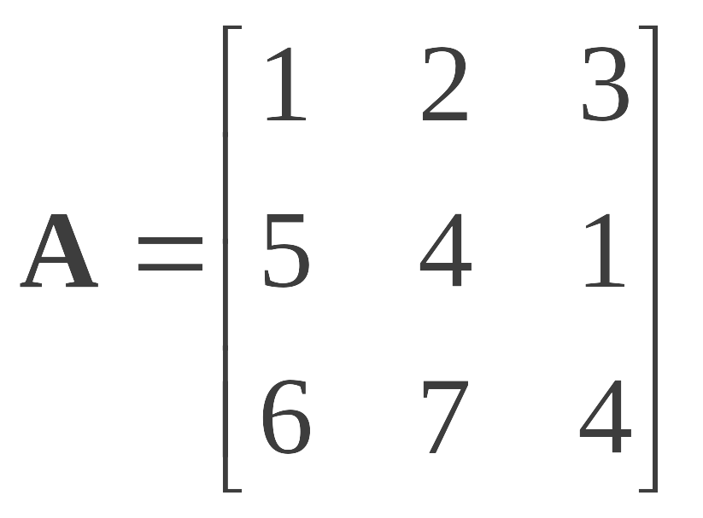
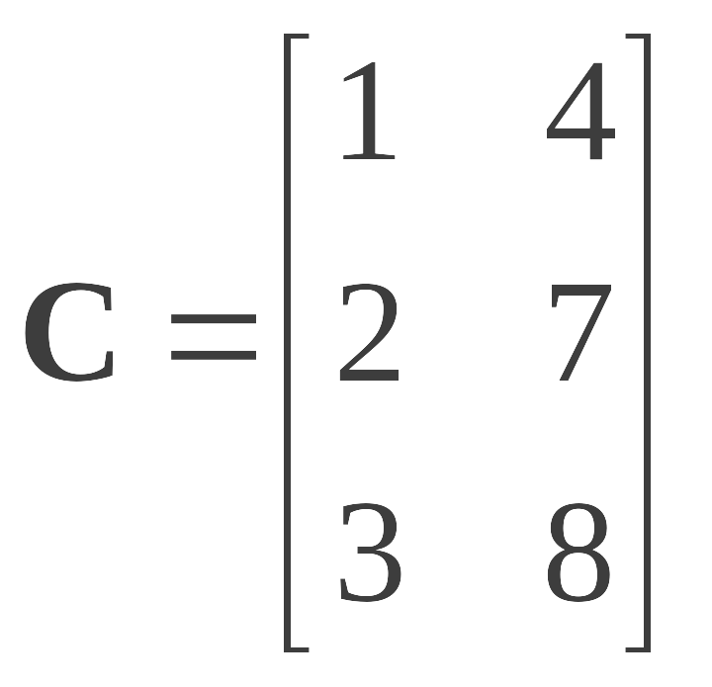
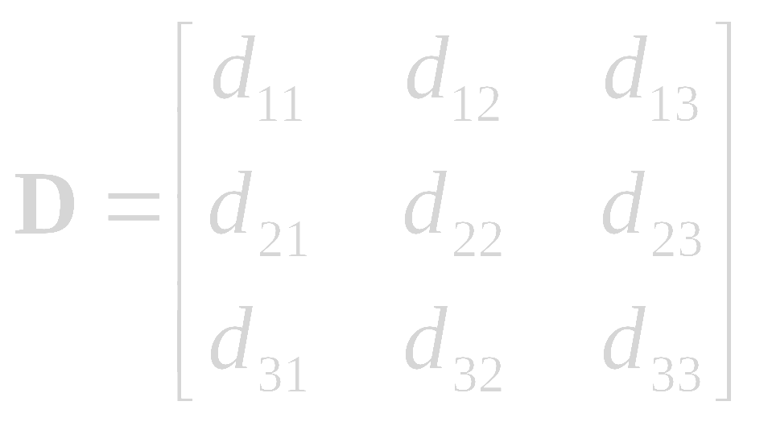
Scalars, vectors and matrices
Scalar: Variable described by a single number – e.g. Image intensity (pixel value)
Vector: Variable described by magnitude and direction
Matrix: Rectangular array of scalars
2
3
Square (3 x 3) Rectangular (3 x 2) d _{r c} : r^{th} row, c^{th} column

Slide 4
Matrices
A matrix is defined by the number of Rows and the number of Columns.
An mxn matrix has m rows and n columns.
A = 4x3 matrix
A square matrix of order n, is an nxn matrix.
Matlab notes ( ; → End of matrix row )
A = [ 21 5 53 ; 5 34 12 ; 6 33 55 ; 74 27 3 ]
To extract data: Matrix name( row, column )
Scalar Data Point A( 1 , 2 ) = 2
Row Vector A( 2 , : ) = [ 5 34 12 ]
Column Vector A( : , 3 ) = [ 53 ; 12 ; 55 ; 3 ]
Smaller Matrix A(2:4,1:2) = [ 5 34 ; 6 33 ; 74 27 ]
Another Matrix A( 2:2:4 , 2:3 ) = [ 34 12 ; 27 3 ]
21 | 2 | 53
5 | 34 | 12
6 | 33 | 55
74 | 27 | 3

Slide 5
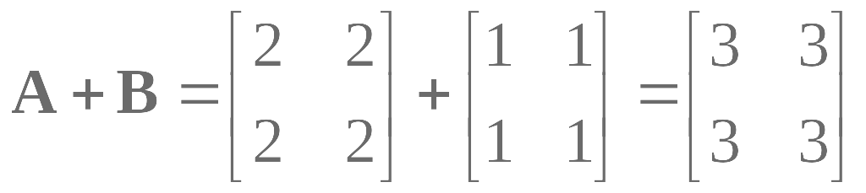
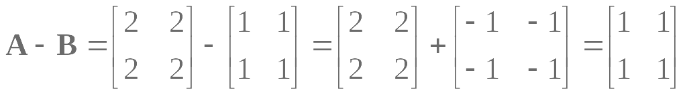
Matrix addition
Addition (matrix of same size)
  Commutative: A+B=B+A
  Associative: (A+B)+C=A+(B+C)
Subtraction consider as the addition of a negative matrix

Slide 6




Matrix multiplication
Constant (or Scalar)
multiplication of a matrix:
Matrix multiplication rule:
When A is a mxn matrix & B is a kxl matrix, the multiplication of AB is only viable if n=k. The result will be an mxl matrix.

Slide 7
Visualising multiplying
A matrix = ( m x n )
B matrix = ( k x l )
A x B is only viable if
k = n
width of A = height of B
Result Matrix = ( m x l )
a₁₁ | a₁₂ | a₁₃ |  | b₁₁ | b₁₂ |  | ? | ?
a₂₁ | a₂₂ | a₂₃ | X | b₂₁ | b₂₂ | = | ? | ?
a₃₁ | a₃₂ | a₃₃ |  | b₃₁ | b₃₂ |  | ? | ?
a₄₁ | a₄₂ | a₄₃ |  |  |  |  | ? | ?
Jen’s way of
visualising the
multiplication
 |  |  |  |  |  | b₁₁ |  |  |  |  |  | b₁₂
 |  |  |  |  |  | b₂₁ |  |  |  |  |  | b₂₂
 |  |  |  |  |  | b₃₁ |  |  |  |  |  | b₃₂
a₁₁ | a₁₂ | a₁₃ |  | a₁₁b₁₁ | + | a₁₂b₂₁ | + | a₁₃b₃₁ |  | a₁₁b₁₂ | + | a₁₂b₂₂ | + | a₁₃b₃₂
a₂₁ | a₂₂ | a₂₃ |  | a₂₁b₁₁ | + | a₂₂b₂₁ | + | a₂₃b₃₁ |  | a₂₁b₁₂ | + | a₂₂b₂₂ | + | a₂₃b₃₂
a₃₁ | a₃₂ | a₃₃ |  | a₃₁b₁₁ | + | a₃₂b₂₁ | + | a₃₃b₃₁ |  | a₃₁b₁₂ | + | a₃₂b₂₂ | + | a₃₃b₃₂
a₄₁ | a₄₂ | a₄₃ |  | a₄₁b₁₁ | + | a₄₂b₂₁ | + | a₄₃b₃₁ |  | a₄₁b₁₂ | + | a₄₂b₂₂ | + | a₄₃b₃₂

Slide 8
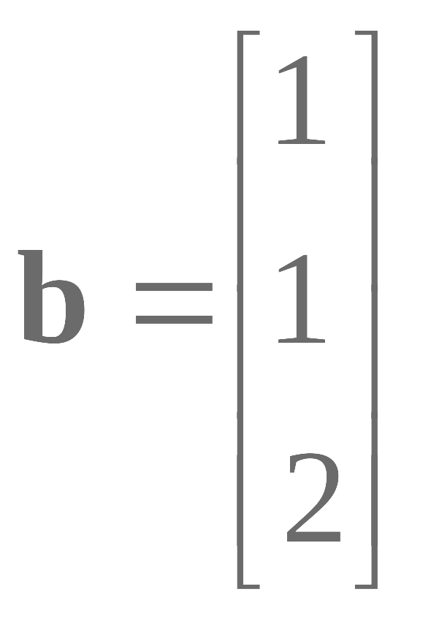
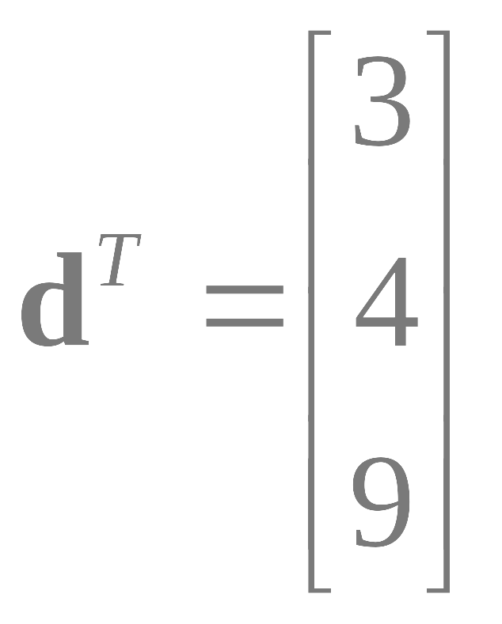

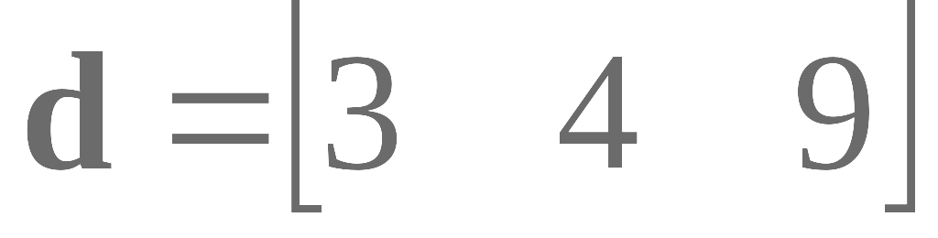
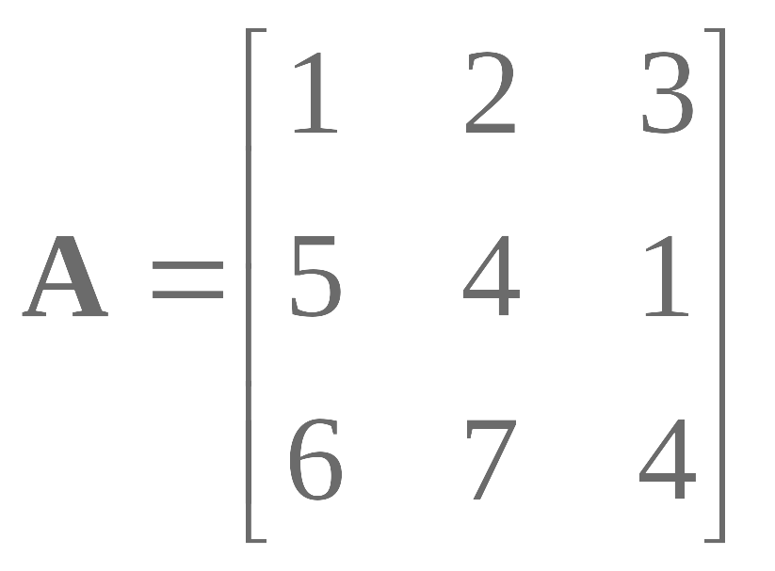
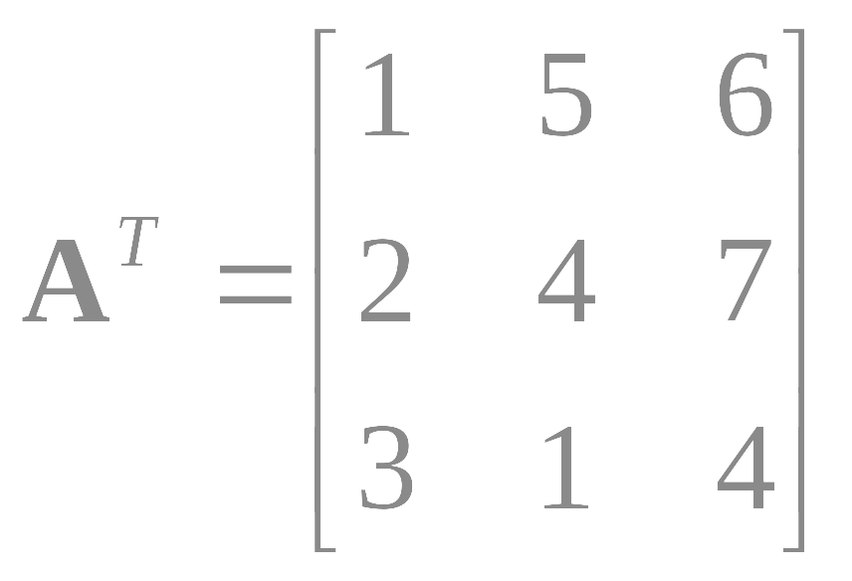
Transposition
column → row row → column
M_{rc} = M_{cr}

Slide 9


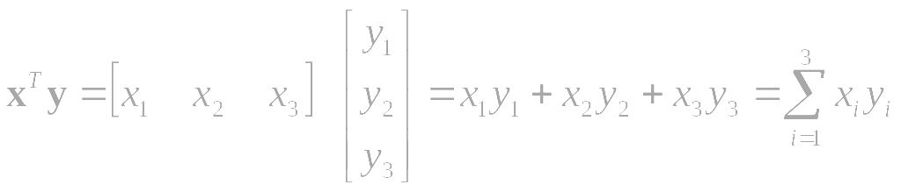
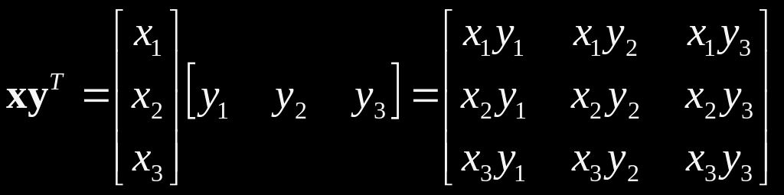
Example
Two vectors:
Inner product = scalar
Note: (1xn)(nx1) → (1X1)
Outer product = matrix
Note: (nx1)(1xn) → (nXn)

Slide 10
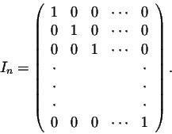
Identity matrices
Is there a matrix which plays a similar role as the number 1 in number multiplication?
Consider the nxn matrix:
A square nxn matrix A has one
A I_{n} = I_{n} A = A
An nxm matrix A has two!!
I_{n} A = A & A I_{m} = A
Worked example
A In = A
for a 3x3 matrix:
1 | 2 | 3 |  | 1 | 0 | 0 |  | 1+0+0 | 0+2+0 | 0+0+3
4 | 5 | 6 | X | 0 | 1 | 0 | = | 4+0+0 | 0+5+0 | 0+0+6
7 | 8 | 9 |  | 0 | 0 | 1 |  | 7+0+0 | 0+8+0 | 0+0+9

Slide 11

Inverse matrices
Definition. A matrix A is nonsingular or invertible if there exists a matrix B such that: worked example:
1 | 1 | X | 2 3 | -1 3 | = | 2 + 1 3 3 | -1 + 1 3 3 | = | 1 | 0
-1 | 2 |  | 1 3 | 1 3 |  | -2+ 2 3 3 | 1 + 2 3 3 |  | 0 | 1
Notation. A common notation for the inverse of a matrix A is A⁻¹.
The inverse matrix A⁻¹ is unique when it exists.
If A is invertible, A⁻¹ is also invertible → A is the inverse matrix of A⁻¹.
If A is an invertible matrix, then (A^{T})⁻¹ = (A⁻¹)^{T}

Slide 12
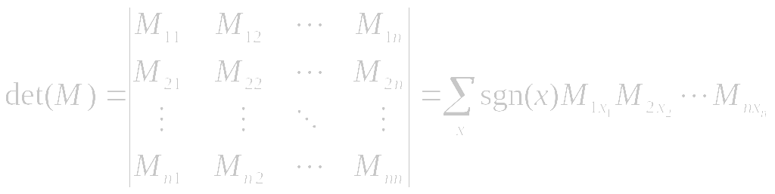
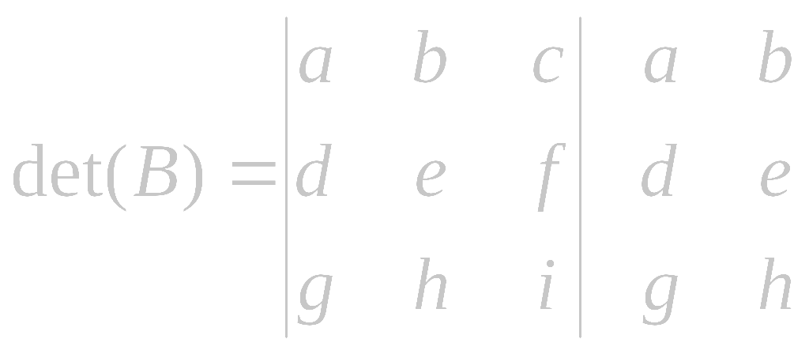
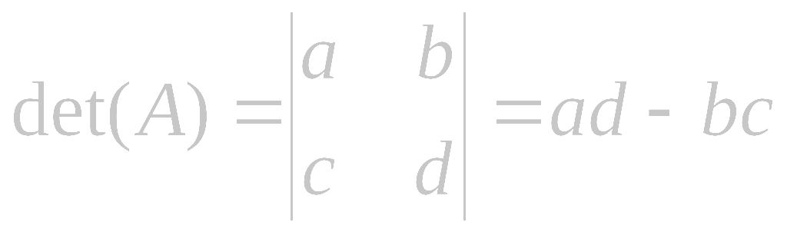
Determinants
Determinant is a function:
  Input is nxn matrix
  Output is a real or a complex number called the determinant
In MATLAB
  use the command det(A)" to compute the determinant of a given square matrix A
A matrix A has an inverse matrix A-1 if and only if det(A)≠0.
-
-
-
+
+
+

Slide 13
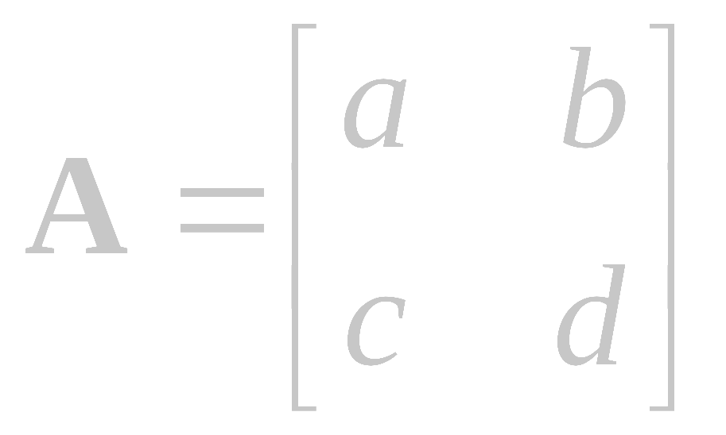
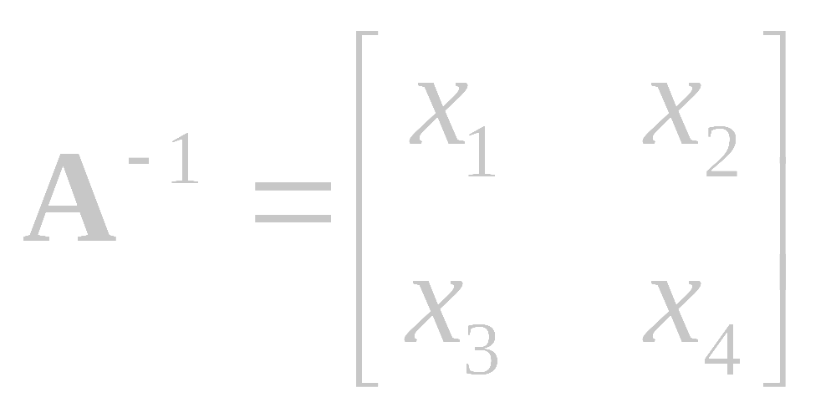
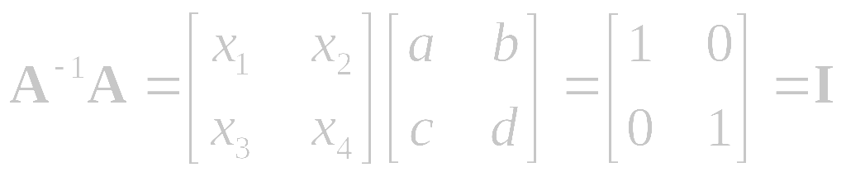
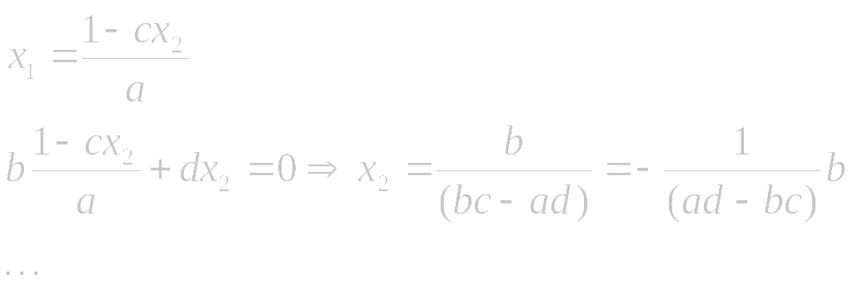
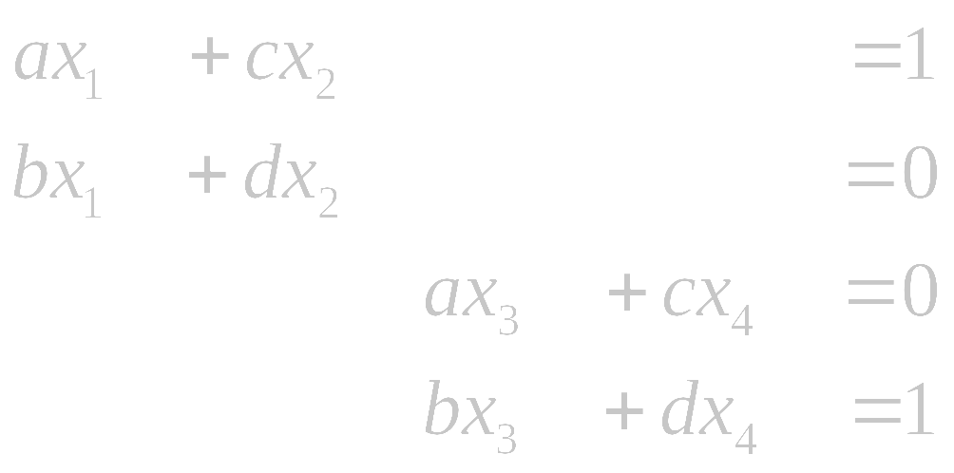
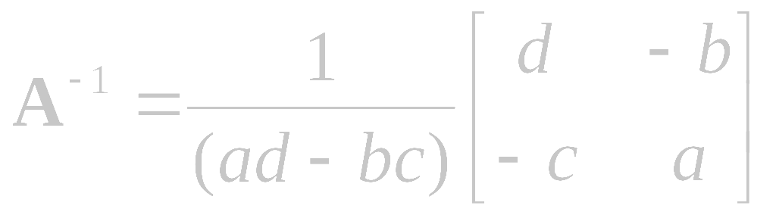
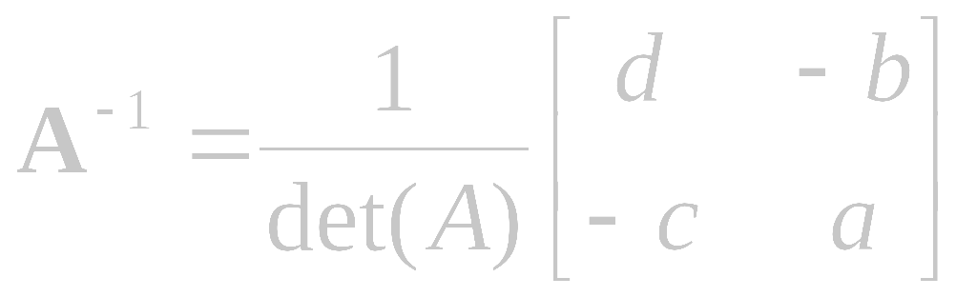
Matrix Inverse - Calculations
i.e.
Note: det(A)≠0
A general matrix can be inverted using methods such as the Gauss-Jordan elimination, Gaussian elimination or LU decomposition

Slide 14
Some Application Areas

Slide 15
Some Application Areas
Simultaneous Equations
Simple Neural Network
GLM

Slide 16
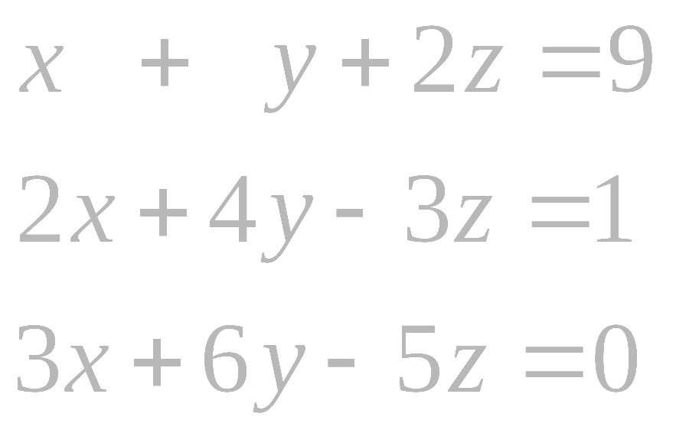
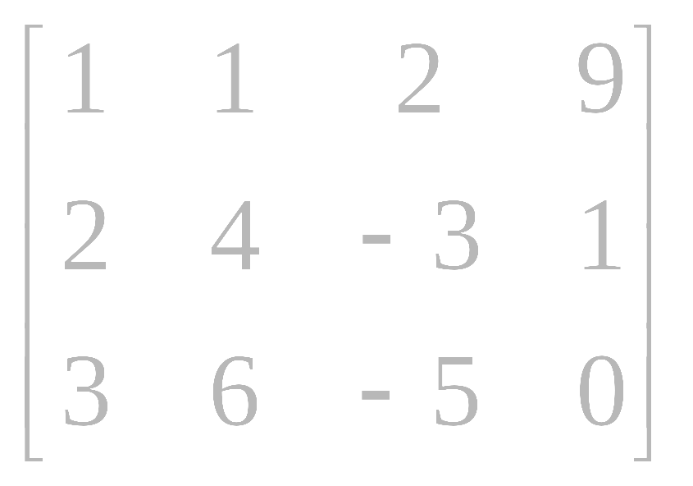
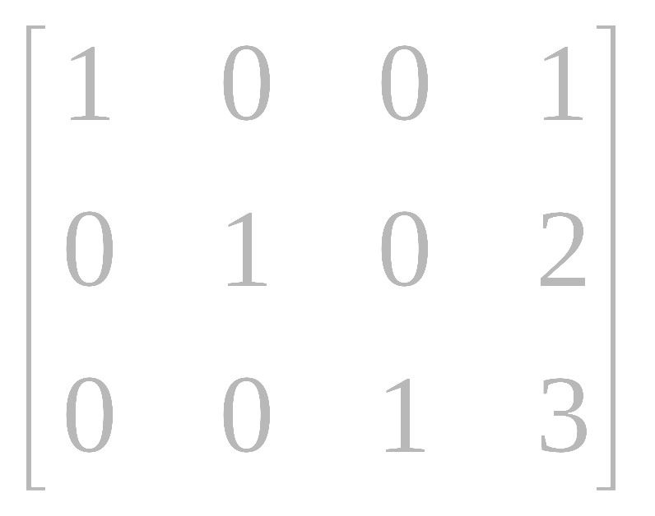
System of linear equations
Resolving simultaneous equations can be applied using Matrices:
➔
Multiply a row by a non-zero constant
Interchange two rows
Add a multiple of one row to another row
Also known as
Gaussian Elimination
…

Slide 17
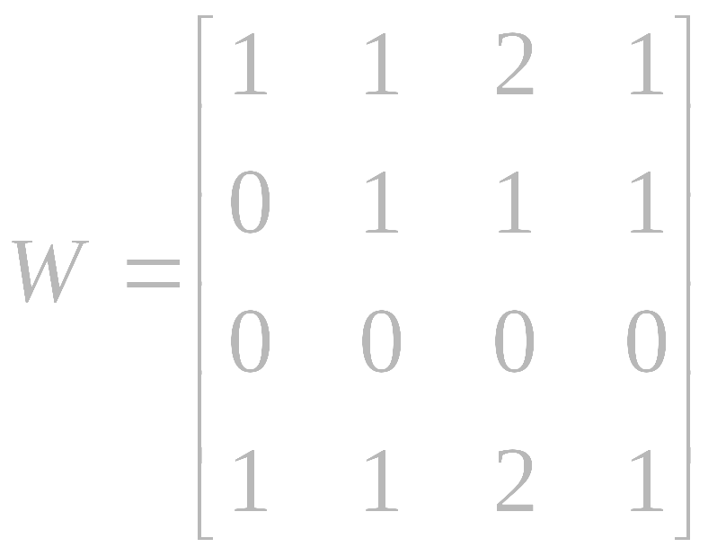
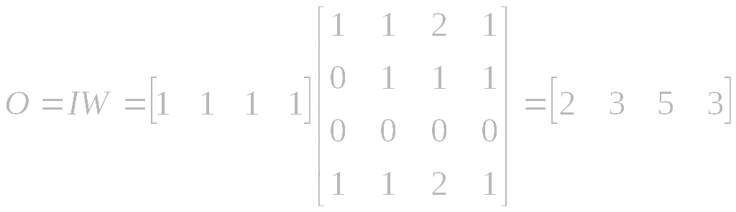

Simplistic Neural Network
Weights learned in auto associative manner or given random values…
O = output vector
I = input vector
W = weight matrix
η = Learning rate
d = Desired output
t = time variable
Given an input, provide an output…
Over time, modify weight matrix to more appropriately reflect desired behaviour

Slide 18



Design Matrix
= the betas (here : 1 to 9)
data vector (Voxel)
parameters
design matrix
error vector
α
μ
β₃
β₄
β₅
β₆
β₇
β₈
β₉
=
+
Y
=
X
×
β
+
ε

Slide 19
Design Matrix
= the betas (here : 1 to 9)
data vector (Voxel)
parameters
design matrix
error vector
α
μ
β₃
β₄
β₅
β₆
β₇
β₈
β₉
=
+
Y
=
X
×
β
+
ε

Slide 20

Questions?

